Slide 1
Flood Insurance Community Meeting
Presented by Heist Insurance Agency
December 18, 2024

Slide 2
Why This Meeting?
Demonstrates our community partnership with FEMA
Provide knowledge to the community to improve disaster recovery
Community rating system (CRS) program allows our community to receive flood discounts for homes built in compliance.

Slide 3
Financial Benefits to the Community
Upper Township is a Class 5 Community
with a 25% discount for eligible flood policyholders!
$350 is the average premium savings per policy
$1,600,000 in total community savings

Slide 4
Building must be in compliance to receive NFIP flood insurance CRS discount
CRS flood insurance discount only available to homes built in compliance with the flood map in effect at the time of construction
After Super Storm Sandy, inspectors found homes throughout the region not in compliance, and they lost their community discount

Slide 5
CRS Goals
Reduce and avoid flood damage to insurable property
Strengthen and support the insurance part of FEMA, which is the NFIP
Rewards towns by way of a discount on their NFIP policies

Slide 6
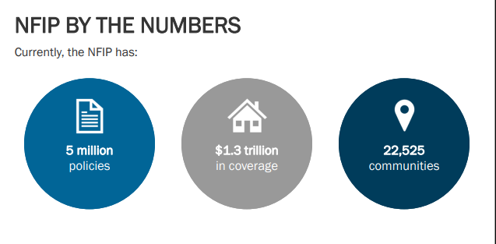
*5% or 1100 communities are CRS communities

Slide 7
Upper Township CRS programs
Public information activities
Online elevation certificates and Flood Insurance Rate Maps available
Annual resident outreach, provide FIRM zone and requirements to callers
Mapping and Regulatory Activities
Continue Open Space, Building Code and Floodplain Management enforcement
Flood Hazard ordinance revised, stormwater management, new construction regulated in accordance with FEMA’s Preliminary Flood Hazard data.

Slide 8
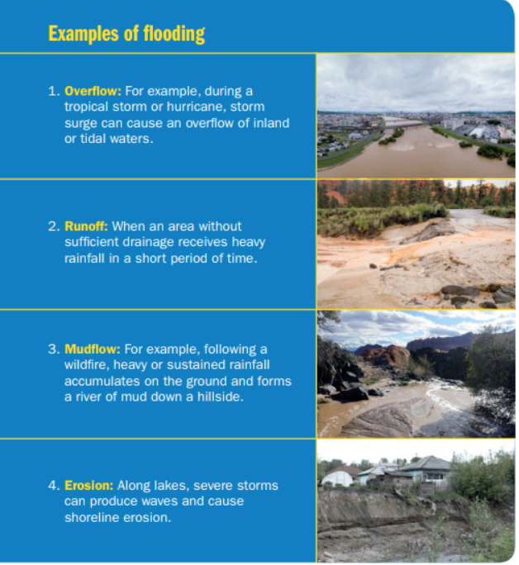
What Is A Flood?
A general and temporary condition where two or more acres of normally dry land or two or more properties are inundated by rising water or mudflow.

Slide 9
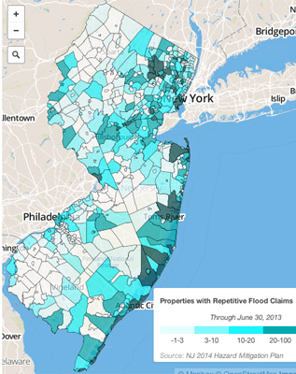
Floods are everywhere
These are areas with repetitive flood losses.

Slide 10
What’s a 100-year flood?
In a bag of 99 green marbles and 1 yellow marble, there is a 1% chance of pulling any marble
When the yellow marble is pulled out of the bag, it represents a 100-year flood event
AKA: The community Base Flood Elevation

Slide 11
The Flood Elevation Certificate (FEC)
The FEC shows you where your home falls on the map and provides specific height information about your home.

Slide 12
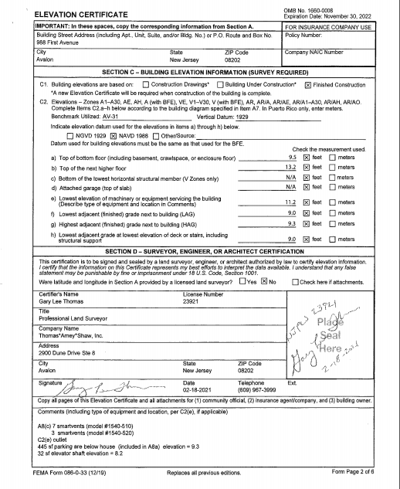
The Flood elevation certificate is not required but can help to get the best flood rate!

Slide 13
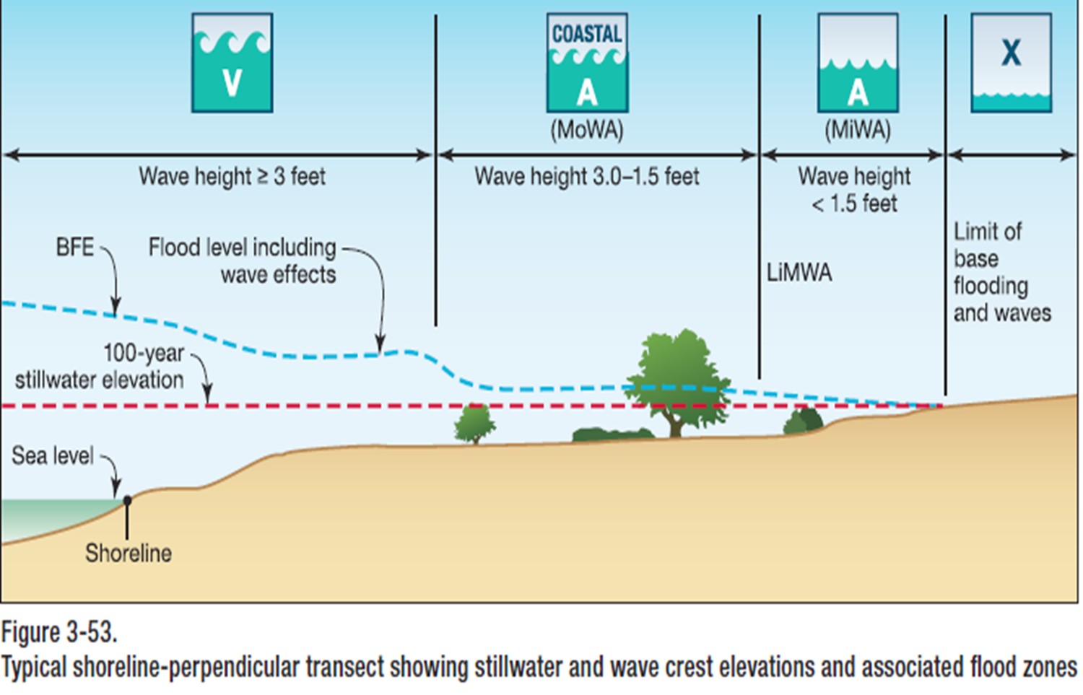
Accumulation Zone
Velocity Zone
Coastal A is A zone BFE with V zone construction requirements

Slide 14
Foundation Flood Openings
Required in enclosures below the Base Flood Elevation (BFE)
Passive flood relief
Equalize hydrostatic loads on enclosure walls
Must allow the automatic entry and exit of floodwaters (bi-directional relief)
Engineered & Non-engineered Options

Slide 15
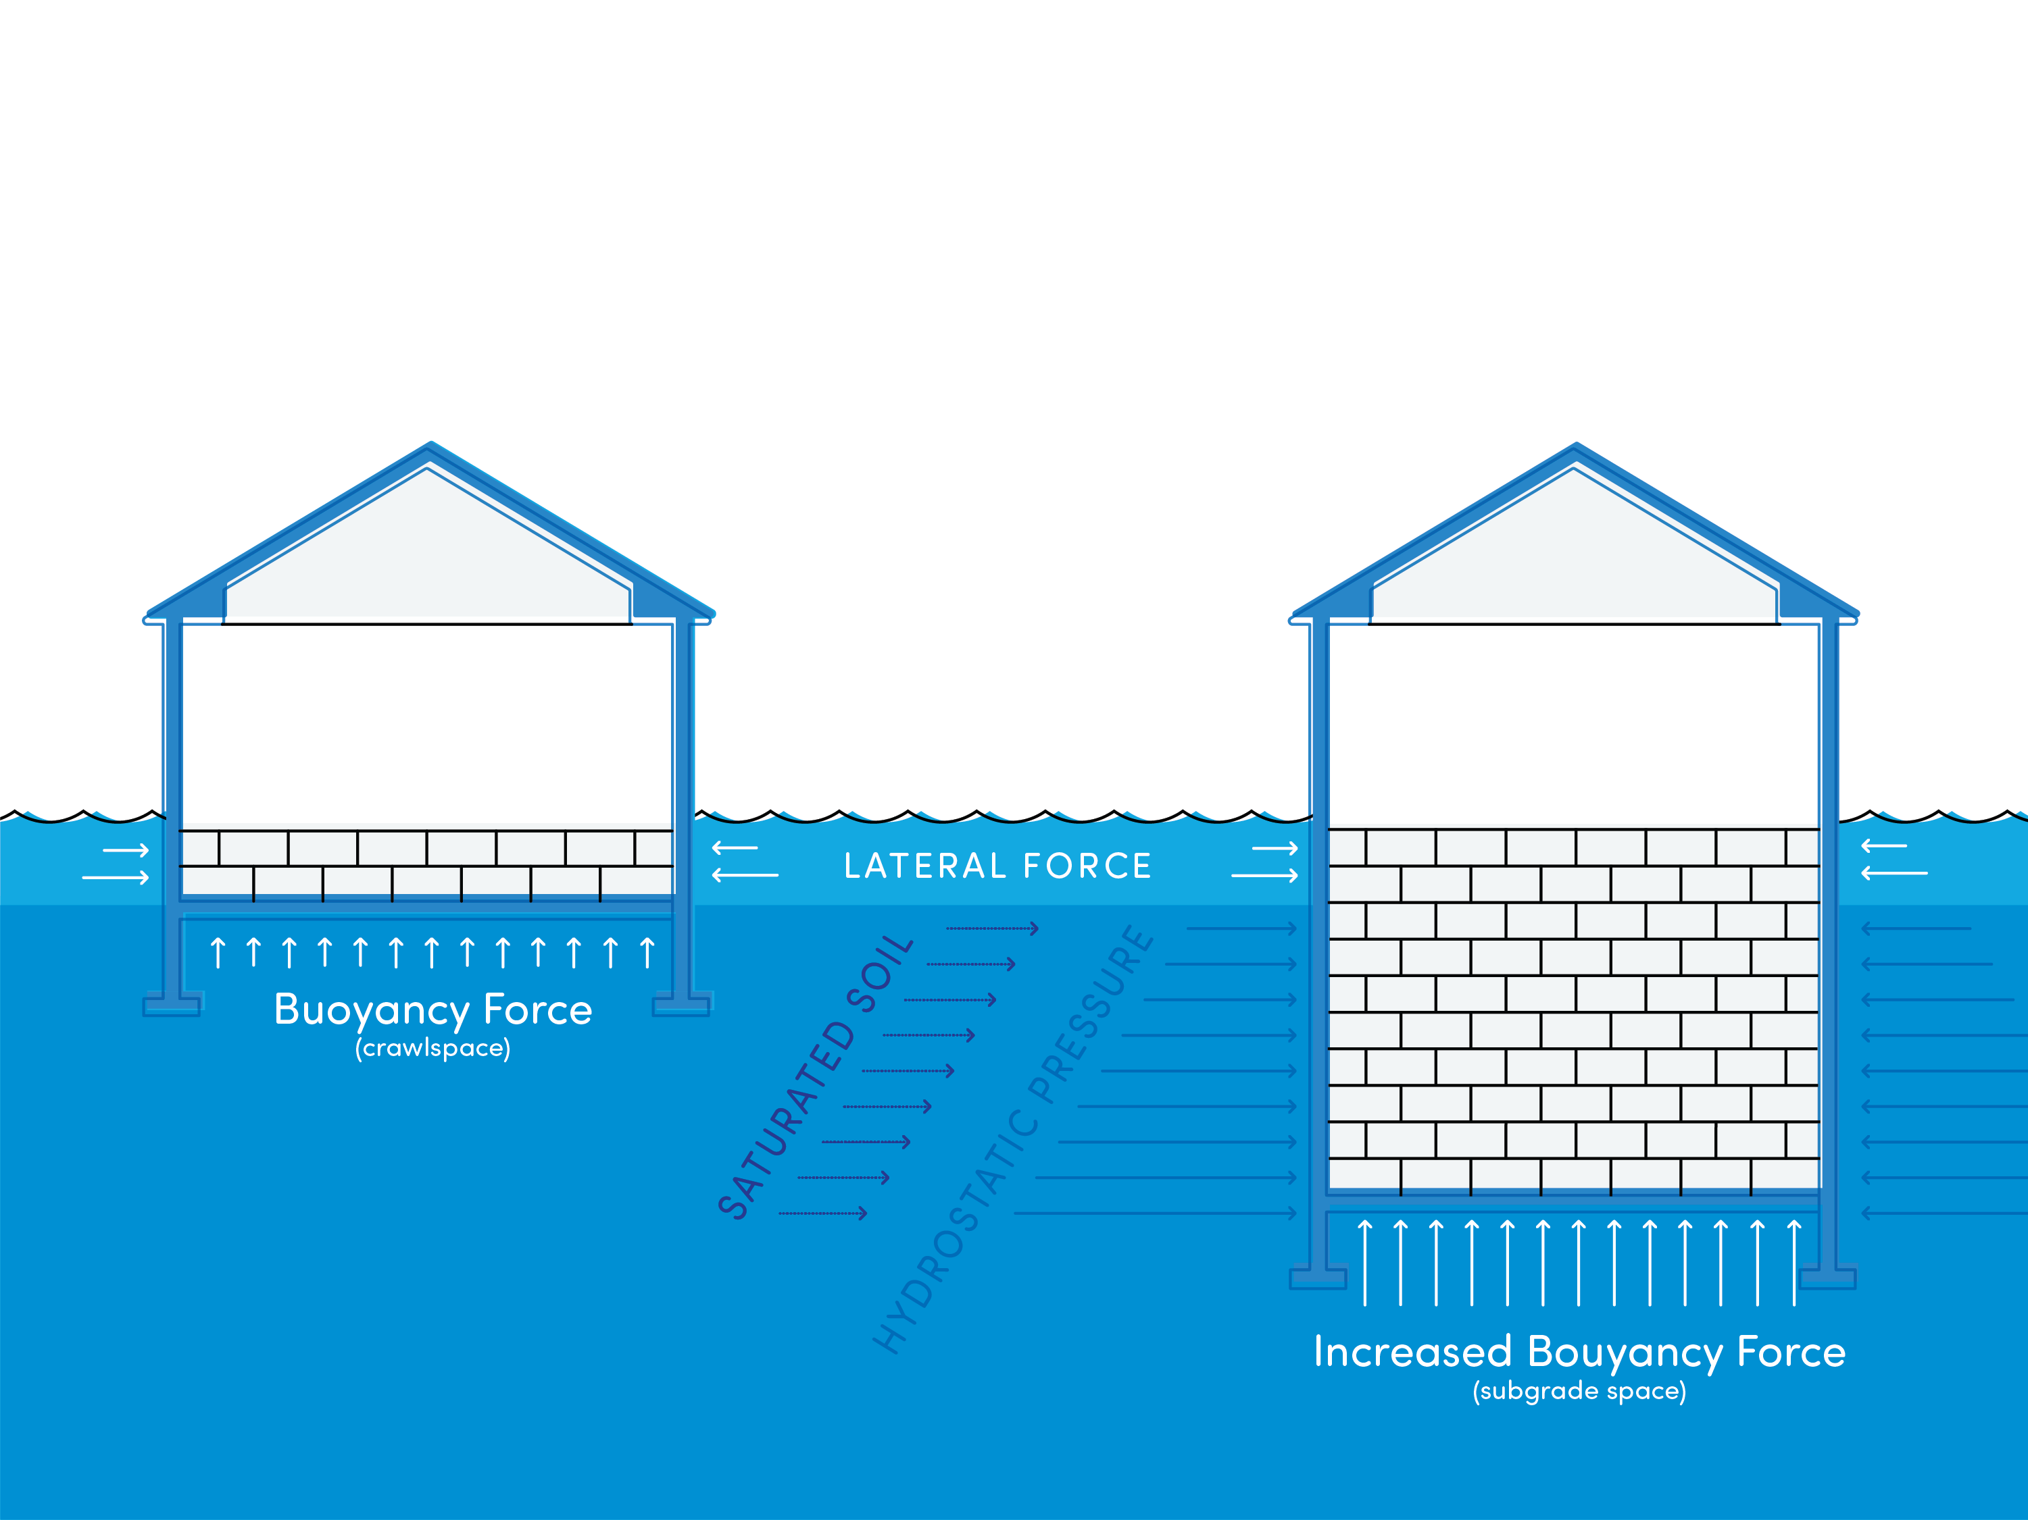
Hydrostatic Pressure

Slide 16
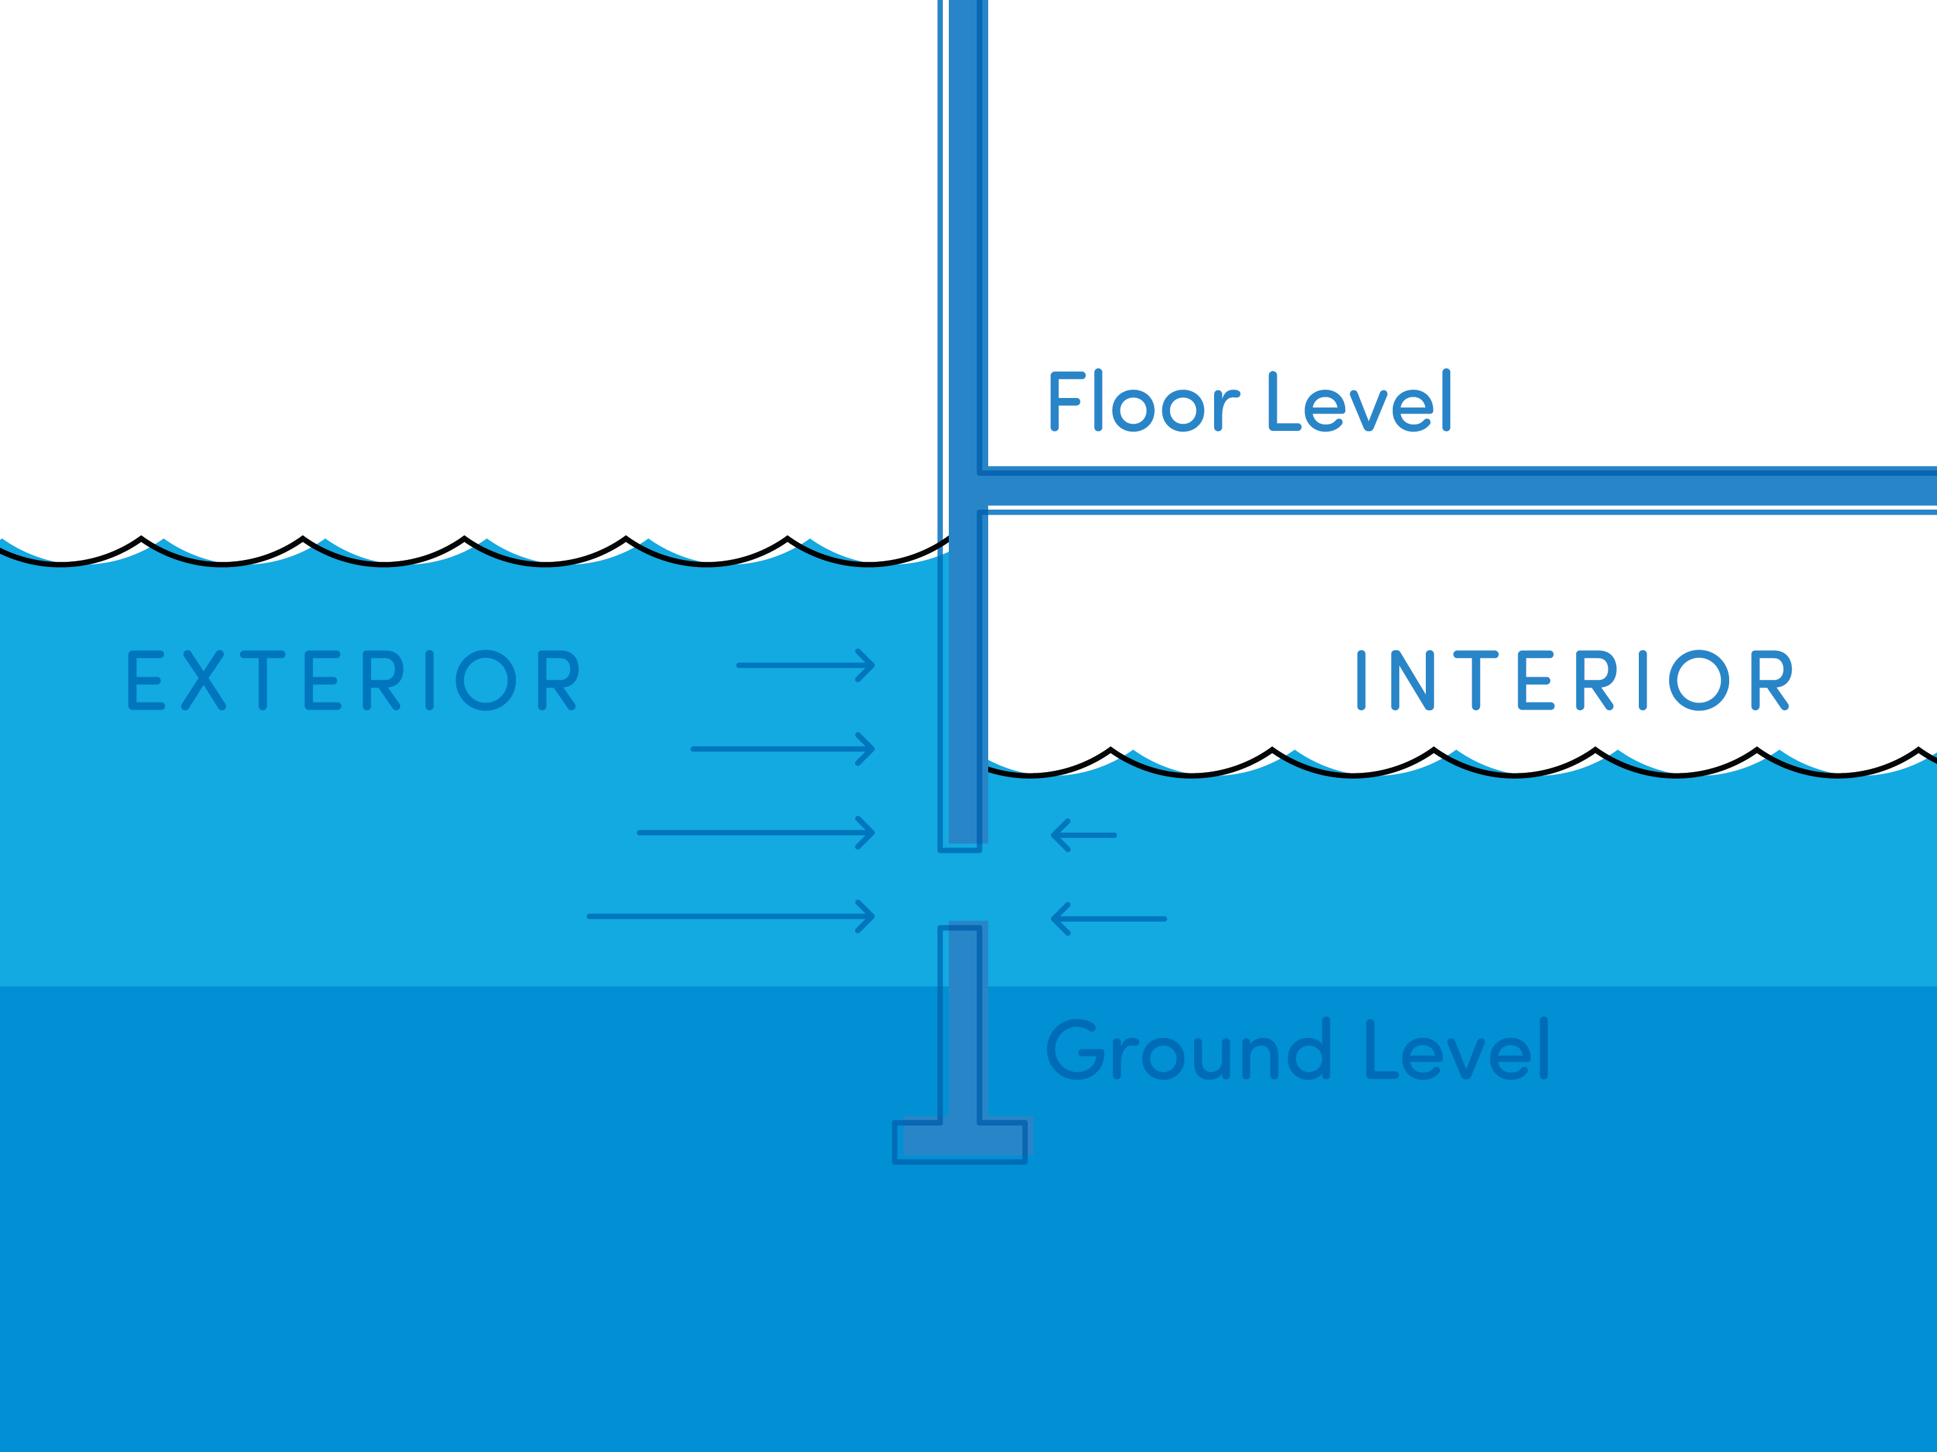
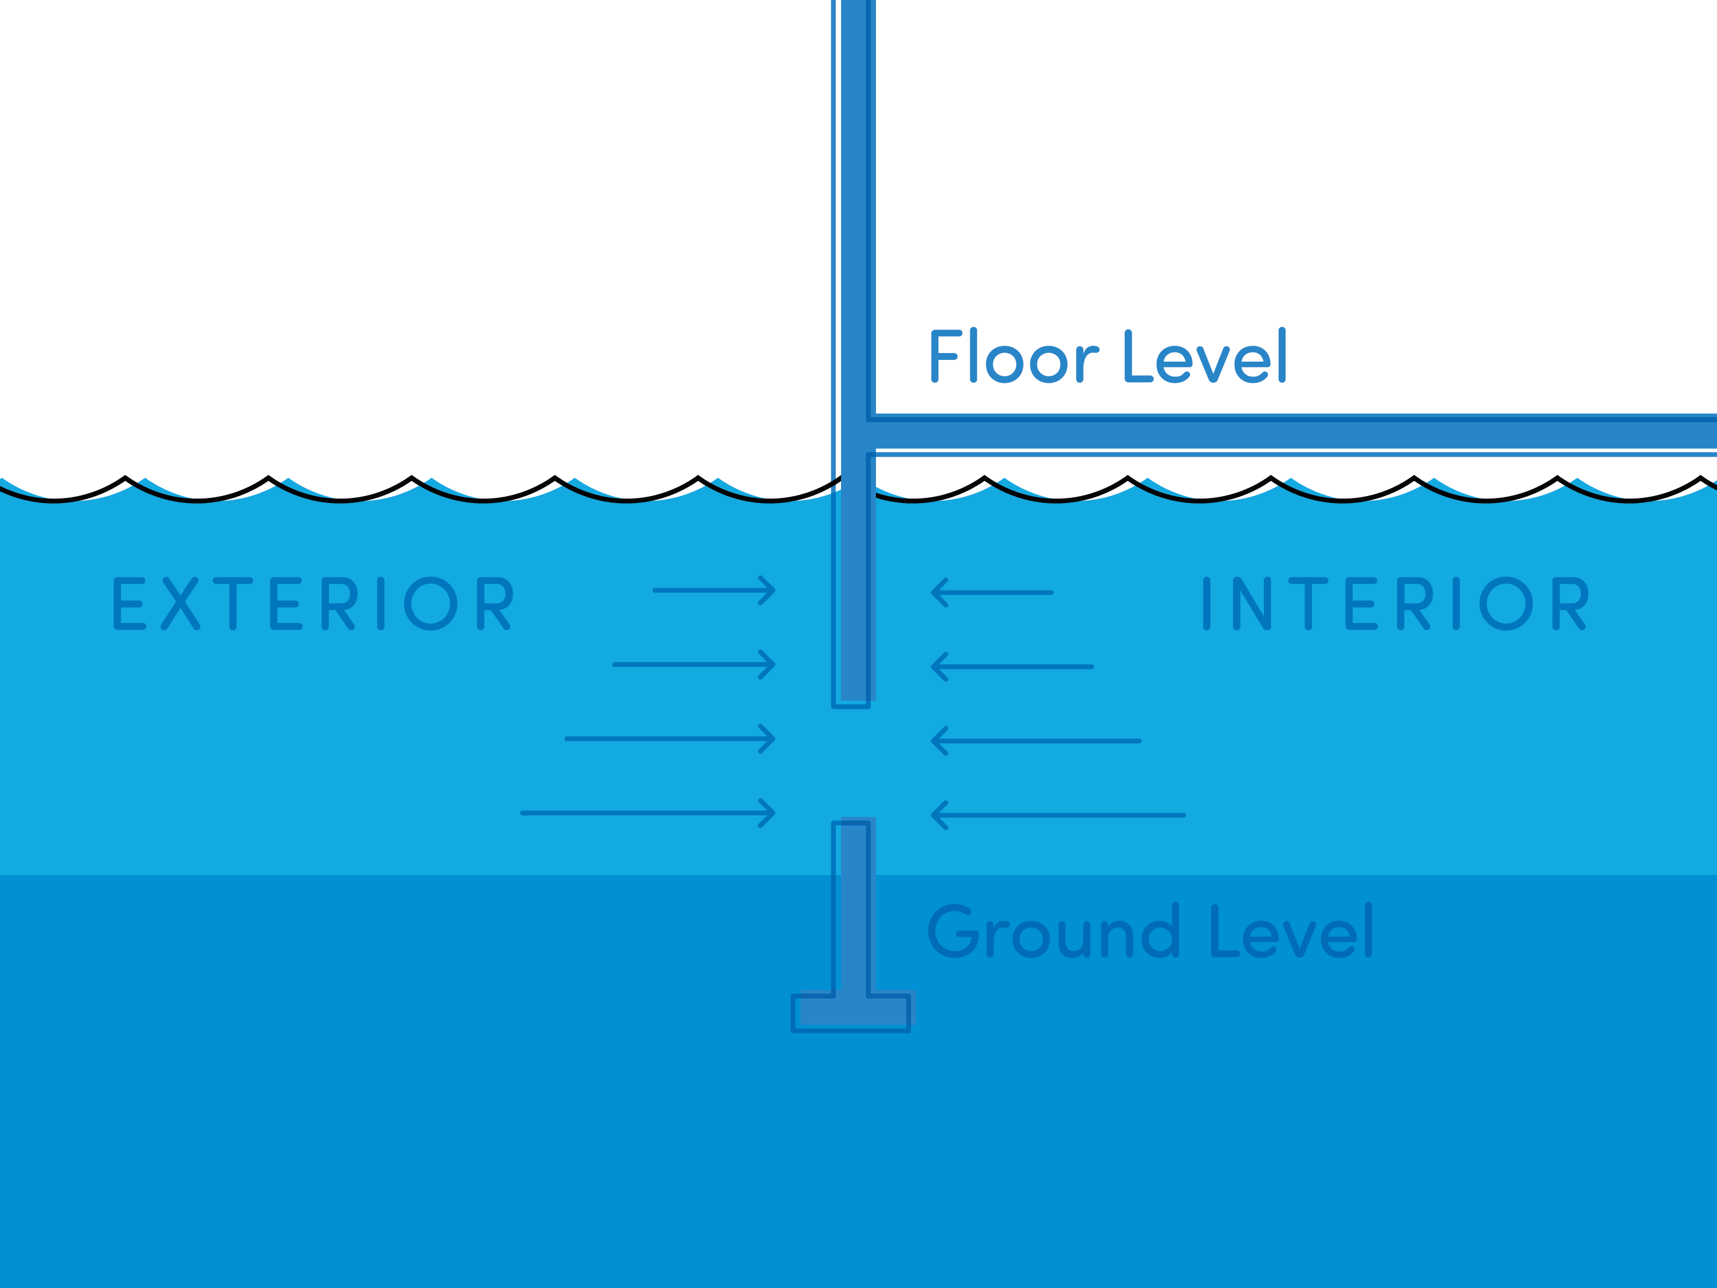

Slide 17
Proper vent certification (EC) allows for more policy discounts.

Slide 18
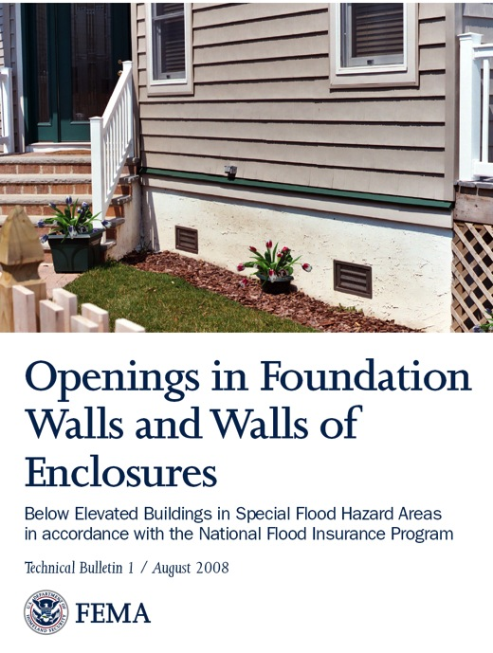
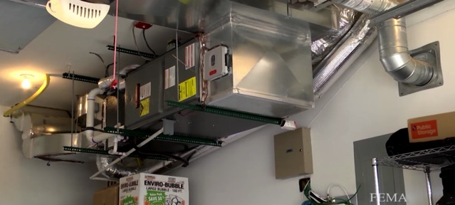
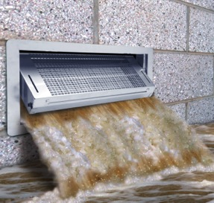
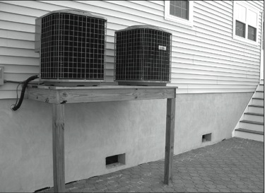
Wet Floodproofing
Required for Residential Applications
Smart option for Non-Residential
Left Hand Side Handout
Notes:
Like we saw in “amazed” video

Slide 19
Risk Rating 2.0
First major rating change to NFIP since implementation of the program
in 1968.
With Risk Rating 2.0, FEMA has updated the NFIP risk rating methodology, effective March 31st, 2023.
Cutting-edge technology is enabling FEMA to deliver rates that are actuarily sound, equitable, easier to understand and better reflect a property’s flood risk.

Slide 21
Risk Rating 2.0 Every structure has a unique flood risk and unique flood premium. 8,
FEMA’s new rating methodology considers specific building characteristics…
Where…
How…
and, What…
to promote a more modern, individualized, and equitable flood insurance rate.

Slide 22
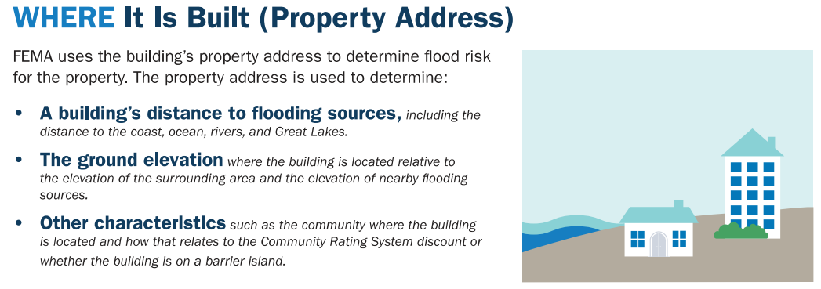

Slide 24
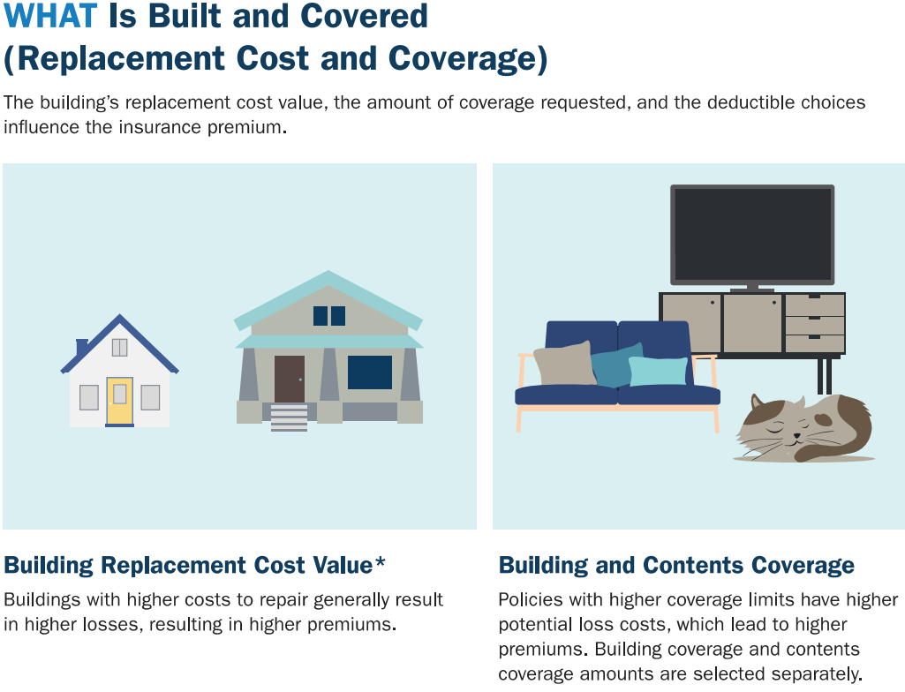

Slide 25
What is “Equity in Action”?
Cost to rebuild is now a significant rating variable.
Think about it, what structure will have a higher claim payment?
$100,000 house with 10” of water.
$1,000,000 house with 10” of water.

Slide 26
Yay, basements are no longer a rating variable!!

Slide 27
Previously all owners paid the same rate, regardless of the floor they lived.

Slide 29
Notes:
Cap 18%

Slide 30
Another Option: Private Market Flood Insurance
NFIP was the only market until the last few years
Lloyds of London and other companies are now competing with the NFIP
Private Market Insurance can have lower premiums and shorter waiting periods for coverage
Rates are not regulated by the NJ Department of Banking and Insurance
Generally, homeowners with previous flood losses less than $15,000 are eligible

Slide 31
In summary: Role of Community
Participate in the community rating system. Prioritized mitigation grants for owners of severe repetitive loss properties. Apply for hazard mitigation assistance grants through the state. Adopt and enforce building codes and zoning regulations.

Slide 32
In Summary: Role of Property Owners
Buy flood insurance. Install flood openings or elevate the home and elevate all machinery and equipment to the base flood elevation. After a flood, NFIP policyholders should consider using increased cost of compliance ICC coverage to access up to 30,000 to help recover the cost of elevating, relocating, or demolishing substantially damaged structures. Severe repetitive loss homeowners should contact their local flood manager and state hazard mitigation officer to learn how up to 100% of mitigation project costs may be covered.

Slide 33
Questions?

